Slide 1
OSS4RS: Open Source Software for the Research Software Community
Colin Sauze, Michael Sparks and Jannetta Steyn

Slide 2
Why don’t we use open source software more?
“Tyranny of the default”
  “Nobody ever got fired for buying Microsoft (IBM)”
More technical expertise required

Slide 3
Our solution

Slide 4
Carpentries Lesson on Open Source Alternatives
Why you should use open source
Tools you can use:
  NextCloud
  More coming soon (Big Blue Button, Jitsi, Mattermost etc)

Slide 5
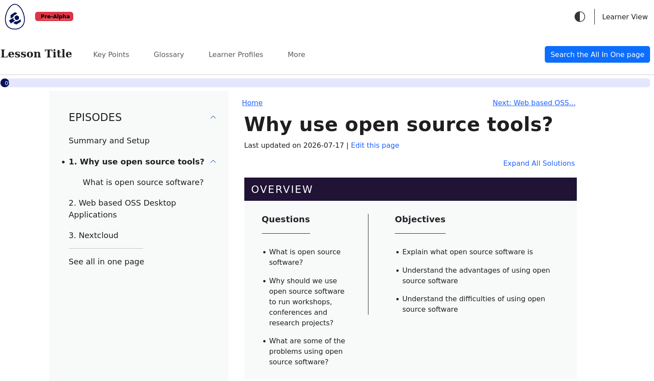
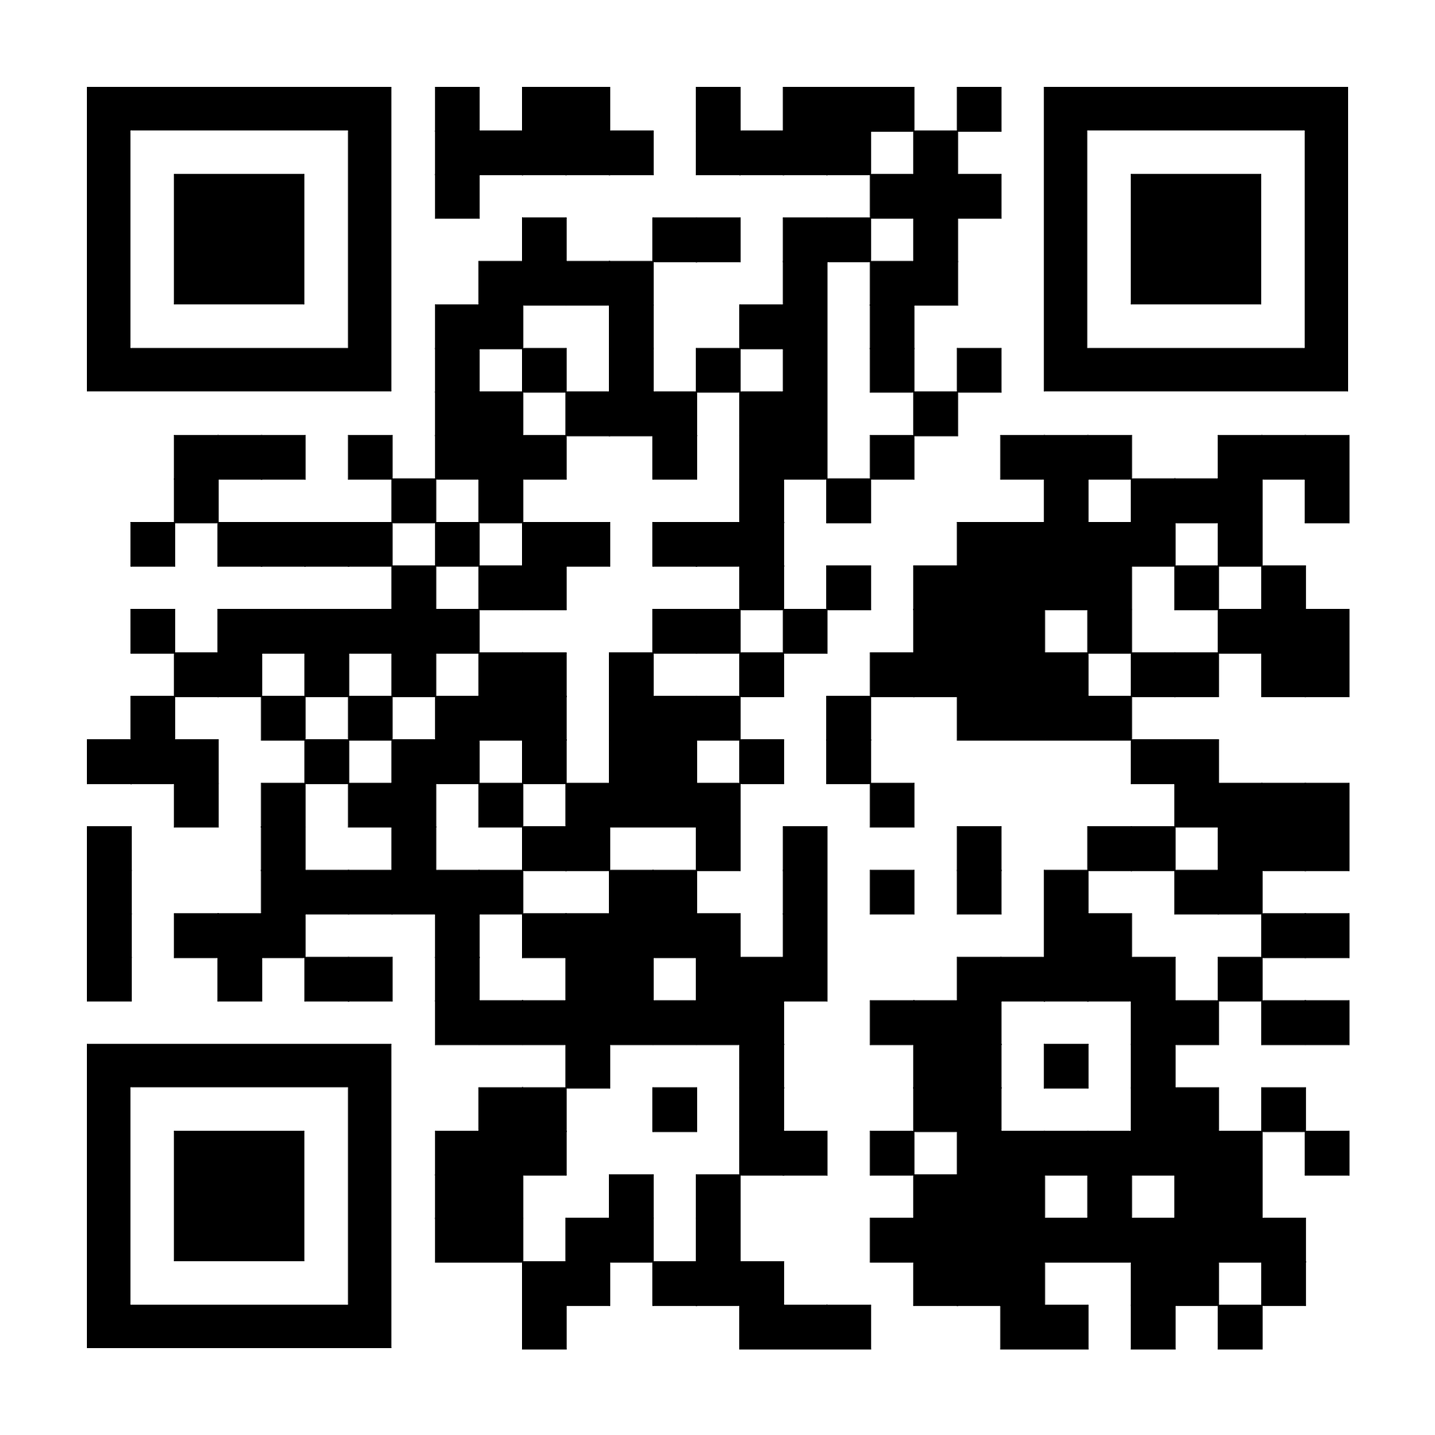
https://github.com/sparkslab/oss4rs

Slide 6
How we worked
Morning:
  Everyone looked at using some of the office tools
    NextCloud (running on Jannetta’s Raspberry Pi at home)
    Cryptpad
    OnlyOffice

Slide 7
How we worked continued
Afternoon:
  Colin – wrote intro section
  Jannetta – wrote Nextcloud section
  Michael – wrote tools section

Slide 8


Thank you!
Thank you

